Slide 1
Chapter 6
Descriptive Statistics

Slide 2
Introduction
Statistics deals with making intelligent judgments and informed decisions in the presence of uncertainty and variation.
One branch of statistics is Descriptive Statistics which is the part of statistics dealing with organizing and summarizing data.

Slide 3
Numerical Summaries of Data
Various numerical measures are given to summarize and describe distributions. Measures of center and spread along with the shape of the distribution give a lot of information about the variable of interest.

Slide 4

Mean – Measure of Center
Let x₁,…,x_{n} denote a random sample of size n. The sample mean is
= (x₁+...+x_{n})/n = ∑x_{i} /n.
Let x₁,…,x_{N} denote the observations of a population. The population mean is
μ = (x₁+...+x_{N})/N = ∑x_{i} /N.

Slide 5
Sample Mean
EXA Consider the grades of a class on the final exam. Assume it is a random sample of grades. Find the sample mean.
45, 90, 62, 80, 45, 92, 74, 79, 91, 86, 85
Notes:
= (45 + 90 + … + 85)/11 = 829/11 = 75.36

Slide 6

Sample Standard Deviation
observation deviation deviation²
x₁ x₁ - (x₁ - )²
x₂ x₂ - (x₂ - )²
. . .
. . .
. . .
x_{n} x_{n} - (x_{n} - )²

Slide 7
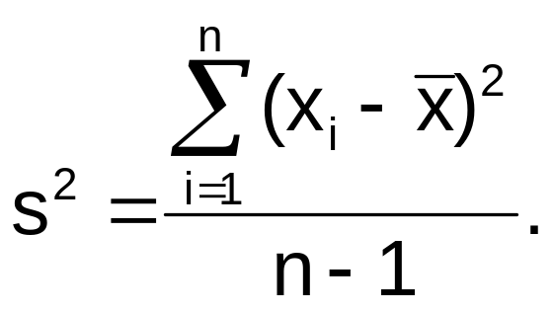
Sample Standard Deviation
Defn The variance of a random sample x₁,...,x_{n} is given by
The standard deviation of such a random sample is s, the square root of s² .

Slide 8
Alternate Formula for s
Alternate formula for s² is
s² = [ ∑ x_{i}² - ( ∑ x_{i})²/n] / (n-1).
This is typically simpler to use.

Slide 9
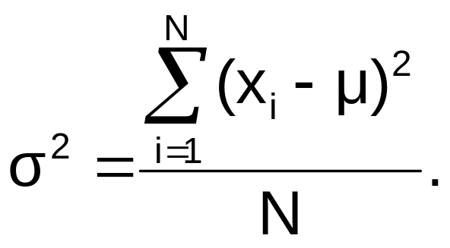
Population Standard Deviation
Defn The variance of a population x₁,...,x_{N} is given by
The population standard deviation is σ, the square root of σ² .

Slide 10
Sample Standard Deviation
EXA Consider the grades of a class on the final exam. Assume it is a random sample of grades. Find the sample standard deviation.
45, 90, 62, 80, 45, 92, 74, 79, 91, 86, 85

Slide 11
Using R
45, 90, 62, 80, 45, 92, 74, 79, 91, 86, 85
> x=c(45,90,62,80,45,92,74,79,91,86,85)
> mean(x)
[1] 75.36364
> sd(x)
[1] 17.32208

Slide 12
Stem and Leaf Plots
Dot diagrams are useful for small data sets. Stem and leaf plots are better for larger data sets. Histograms are better for large data sets.

Slide 13
Stem and Leaf Plots
Steps to construct a stem-and-leaf diagram:
  Divide each number (x_{i}) into two parts: a stem, consisting of the leading digits, and a leaf, consisting of the remaining digit(s).
  List the stem values in a vertical column.
  Record the leaf for each observation beside its stem.
  Give a legend.

Slide 14
Stem and Leaf Plots
EXA Grades of a class on the final exam.
45, 90, 62, 80, 45, 92, 74, 79, 91, 86, 85
Notes:
4 |55
5 |
6 |2
7 |49
8 |065
9 |021
Legend: 4|5 = 45
Shape is skewed to the left with two possible outliers.

Slide 15
Stem and Leaf Plots
EXA GPA’s of a group of students.
2.31, 3.91, 2.45, 3.10, 1.46, 2.73, 3.09, 2.64,
2.89, 3.12, 3.52, 1.88, 2.66, 2.41, 2.91, 3.04
Notes:
1 | 46,88
2 | 31,45,73,64,89,66,41,91 (Legend: 1|46 = 1.46)
3 | 91,10,09,12,52,04
put in order
1 | 46,88
2 | 31,41,45,64,66,73,89,91
3 | 04,09,10,12,52,91
two lines per stem
1* | 46
1• | 88
2* | 31,41,45
2• | 64,66,73,89,91
3* | 04,09,10,12
3• |52,91 Slightly skewed to left.

Slide 16
Dot Diagrams
EXA Grades of a class on the final exam.
45, 90, 62, 80, 45, 92, 74, 79, 91, 86, 85
Notes:
•
• • • •• •• •••
__ ___ ___ ___ ___ ___ ___ ___ ___ ___ ___ ___ ___
40 45 50 55 60 65 70 75 80 85 90 95

Slide 17
Side by Side Stemplots
EXA Make side by side stemplots of home run data for Babe Ruth and Roger Maris
Babe Ruth: 22, 25, 34, 35, 41, 41, 46, 46,
46, 47, 49, 54, 54, 59, 60
Roger Maris: 8, 13, 14, 16, 23, 26, 28, 33,
39, 61
Notes:
|0|8
|1|346
52 |2|368
Babe 54 |3|39 Roger
9766611 |4|
944 |5|
0 |6|1
Legend: 1|3 = 13
Babe symmetric. Roger symmetric with possible outlier of 61.

Slide 18
Sample Percentiles
The 100pth percentile is the value x_{p} such that approximately 100p% of the sample are below x_{p.}.
How to find it? Order the data. Compute np.
1. np = k.** ⇒ 100pth percentile = (k+1)st
2. np = k ⇒ 100pth percentile =(kth+(k+1)st)/2

Slide 19
Sample Percentiles
4 |55
5 | Find 20th percentile.
6 |2
7 |49
8 |056
9 |012
Legend: 4|5 = 45
Notes:
p = 0.2
(11)(0.2) = 2.2 → 3
So 20th percentile = 3rd ordered observation = 62.
Note that 80th percentile
= 3rd ordered observation when you start at largest value
= 90

Slide 20
Sample Percentiles
4 |55
5 | Find 20th percentile.
6 |2
7 |49
8 |056
9 |01 (take 92 away – now n = 10)
Legend: 4|5 = 45
Notes:
p = 0.2
(10)(0.2) = 2
So 20th percentile = (2nd + 3rd ordered observations)/2 = (45 + 62)/2
= 107/2 = 53.5
Note that 80th percentile = (90 + 86)/2 = 176/2 = 88

Slide 21
Sample Median and Quartiles
Q₁ = first quartile = 25th percentile
Q₃ = third quartile = 75th percentile
M = second quartile = 50th percentile = median

Slide 22
Sample Median and Quartiles
4|55
5| Find the median, and first and
6|2 third quartiles.
7|49
8|056
9|012
Legend: 4|5 = 45
Notes:
Median p = 0.5
(11)(0.5) = 5.5 → 6 So M = 6th ordered obs = 80
Q1 p = 0.25
(11)(.25) = 2.75 → 3 So Q1 = 3rd ordered obs = 62
Q3 Q3= 3rd ordered obs from large end = 90

Slide 23
Interquartile Range
Defn IQR = Q₃ - Q₁.
EXA In class data, IQR = 90 - 62 = 28.
Note: IQR and s are measures of spread.

Slide 24
Histograms
EXA Survival times (in days) of guinea
pigs in an experiment.
43 45 53 56 56 57 58 66 67 73
74 79 80 80 81 81 81 82 83 83
84 88 89 91 91 92 92 97 99 99
100 100 101 102 102 102 103 104 107 108
109 113 114 118 121 123 126 128 137 138
139 144 145 147 156 162 174 178 179 184
191 198 211 214 243 249 329 380 403 511
522 598

Slide 25
Strategy
1. Divide range into classes of equal length.
2. Tally frequency and/or % for each class
interval.
3. Make histogram.
Notes:
1. Divide range into classes of equal length.
Here range = 598 - 43 = 555
Square root of 72 = 8.485 - gives us an idea of how many class intervals to use – say 8 or 9.
Say we want 8 class intervals of equal length.
555/8 = 69.375 → 70

Slide 26
Histogram
Make frequency table.
Notes:
2. Tally frequency and/or % for each class interval.
Int Freq. %
[40,110) 41 56.9
[110,180) 18 25.0
[180,250) 7 9.7
[250,320) 0 0
[320,390) 2 2.8
[390,460) 1 1.4
[460,530) 2 2.8
[530,600) 1 1.4

Slide 27
Histogram
Make graph.
Notes:
Shape is skewed to the right.

Slide 28
Turn Stemplot into Histogram
We can turn a stemplot into a histogram with the obvious class intervals.
Babe Ruth: 22, 25, 34, 35, 41, 41, 46, 46,
46, 47, 49, 54, 54, 59, 60
Notes:
2 |25
3 |45
4 |1166679
5 |449
6 |0

Slide 29
Turn Stemplot into Histogram
Make graph.
Notes:
Shape is symmetric.

Slide 30
Using R
> stem(hr)
The decimal point is 1 digit(s) to the right of the |
2 | 25
3 | 45
4 | 1166679
5 | 449
6 | 0
> hist(hr)

Slide 31
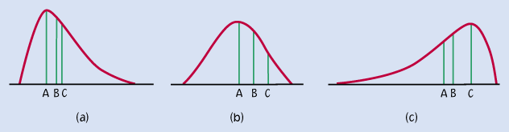
Histogram Shapes
Notes:
(a) skewed to the right of positively skewed (unimodal)
(b) symmetric (unimodal)
(c) skewed to the left or negatively skewed (unimodal)
make a picture of bimodal

Slide 32
Bar Charts
For categorical data, make a bar chart.
EXA Make bar chart for favorite pro sport for a sample of 50 individuals.
NFL NBA NFL MLB MLB NHL NFL NFL MLS MLB
MLB NFL MLB NBA NBA NFL NFL NFL NHL NBA
NBA NFL NHL NFL MLS NFL MLB NFL MLB NFL
NHL MLB NHL NFL NFL NFL MLB NFL NBA NFL
MLS NFL MLB NBA NFL NFL MLB NBA NFL NFL
Notes:
FAV PRO
LEAGUE Freq. % _
MLB 11 22.0
MLS 3 6.0
NBA 8 16.0
NFL 23 46.0
NHL 5 10.0
Total 50 100.0

Slide 33
Boxplots
The simplest boxplot is the box and whiskers plot which is based on the five number summary (min, Q₁, M, Q₃, max).
_________________
×-----|______|___________|-------------×
____________________________________
min Q₁ M Q₃ max
EXA Class data
Notes:
4 |55 Five number summary is (45, 62, 80, 90, 92).
5 |
6 |2
7 |49
8 |056
9 |012
_________________
×----------------|__________|______|--×
---------------------------------------------------------------------------------------------
40 50 60 70 80 90 100

Slide 34
Boxplots Showing Outliers
Compute 1.5×IQR and 3×IQR.
<--outliers--> <--outliers-->
extreme mild mild extreme
| | | |
o ×----|_|_|--× o •
____________________________________
Q₁-3IQR Q₁-1.5IQR Q₁ M Q₃ Q₃+1.5IQR Q₃+3IQR

Slide 35
Boxplots Showing Outliers
EXA Consider 25 pulse widths.
5.3, 8.2, 13.8, 74.1, 85.3, 88.0, 90.2, 91.5, 92.4, 92.9, 93.6, 94.3, 94.8, 94.9, 95.5, 95.8, 95.9, 96.6, 96.7, 98.1, 99.0, 101.4, 103.7,
106.0, 113.5
Notes:
Q₁: 25(.25) = 6.25 → 7 ⇒ Q₁ = 7th = 90.2
Q₃: 25(.75) = 18.75 → 19 ⇒ Q₃ = 19th = 96.7
M: 25(.5) = 12.5 → 13 ⇒ M = 13th = 94.8
IQR = 96.7 - 90.2 = 6.5, 1.5×IQR = 9.75, 3×IQR = 19.5
Q₁-1.5IQR = 90.2 - 9.75 =80.45
Q₁-3IQR = 90.2 - 19.5 = 70.7
Q₃+1.5IQR = 96.7 + 9.75 = 106.45
Q₃+3IQR = 96.7 + 19.5 = 116.2
•• • o ×--|_||------× o
_________________________________________________________
0 10 20 30 40 50 60 70 80 90 100 110 120

Slide 36
Comparative Boxplots
EXA Make side by side boxplots of home run data for Babe Ruth and Roger Maris
Babe Ruth: 22, 25, 34, 35, 41, 41, 46, 46,
46, 47, 49, 54, 54, 59, 60
Roger Maris: 8, 13, 14, 16, 23, 26, 28, 33,
39, 61
Notes:
Babe: 5 number summary = (22, 35, 46, 54, 60)
Roger: 5 number summary = (8, 14, 24.5, 33, 61)
Make the comparative boxplots.

Slide 37
Time Plots
A time series plot shows the data value, or statistic, on the vertical axis with time on the horizontal axis.
A time series plot reveals trends, cycles or other time-oriented behavior that could not be seen in the data.

Slide 38
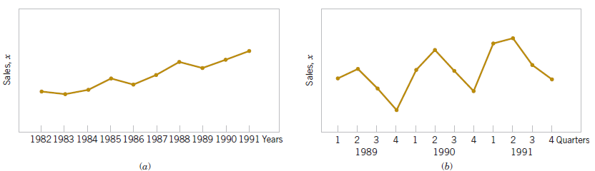
Time Plots
Figure 6-16 Company sales by year (a). By quarter (b).

Slide 39
Scatterplot
EXA With respect to daytime eruptions of Old Faithful in Yellowstone Park, it is believed that there is a relationship between duration of an eruption (X) and time to the next eruption (Y) (both in minutes). Below is data for a sample of size 10.
x | 4.4 3.9 4.0 4.0 3.5 4.1 4.2 3.4 4.9 3.7
y | 80 62 74 69 57 74 75 55 93 60
Notes:
Duration is the natural explanatory variable so put it on the x axis.

Slide 40
Scatterplot Using R
x=c(4.4,3.9,4,4,3.5,4.1,4.2,3.4,4.9,3.7)
y=c(80,62,74,69,57,74,75,55,93,60)
plot(x,y,xlab="duration of eruption",ylab="time to next eruption")

Slide 41
Interpretation of a Scatterplot
The idea is to look for an overall pattern and look for deviations from that pattern.
Describe the overall pattern of a scatterplot by the form, direction, and strength.
Look for positive association () or negative association (). Look for a linear pattern. How strong (striking) is the relationship? Are there clusters? Are there outliers?

Slide 42
Probability Plot
Probability plots are used to see if a certain distribution is a good model for the data.
Consider Babe Ruth’s home run data. Looks pretty normal from stemplot and histogram.
Will skip details here, but R code can save us some time. (see below for details)
Notes:
IDEA For Babe Ruth data,
1. Put data in order. (x=sort(x)) Compute the place in the order divided by the sample size (adjusted). ((x-.5)/15) ((x-.5)/15 represents the left hand area under N(0,1) curve)
2. Find the value that produces (x-.5)/15 left hand area under the N(0,1) curve; this is the ((x-.5)/15)100th percentile. (xx=qnorm((x-.5)/15))
3. Plot (percentile, ordered IQ) for the whole sample. (plot(xx,x))
Use Babe Ruth’s Home Run data from 1920 to 1934 when he was with the Yankees: 54 59 35 41 46 25 47 60 54 46 49 46 41 34 22.
Note: If you use x/15 vs. (x-.5)/15, qqnorm(1) is infinity!!
brhr=c(54,59,35,41,46,25,47,60,54,46,49,46,41,34,22)
brhr=sort(brhr)
x=seq(1,15,by=1)
xx=qnorm((x-.5)/15)
plot(xx,brhr)

Slide 43
Probability Plot
hr=c(22,25,34,35,41,41,46,46,46,47,49,54,54,59,60)
qqnorm(hr)
If plot looks fairly linear, then normal model is a good fit; otherwise, normal model is not a good fit.
See Figure 6-24.

